Slide 1
GIS and RS for Forest Resource Assessment
Kefyalew Sahle Hawassa University
Wondo Genet College of Forestry and Natural Resources
GIS Department

Slide 2
Unit 8. National and global forest mapping initiatives

Slide 3
Remote sensing types for global and national level mapping
The success of land-cover studies is directly related to the availability of satellite imagery at the desired spatial and temporal resolution.
Concerning the spatial resolution of existing satellite systems, three main categories of sensors can be defined:
coarse to medium-resolution sensors (> 250 m);
high-resolution sensors (> 10 m);
very high-resolution sensors (< 10 m).

Slide 4
Remote sensing types for global and national level mapping
These spatial resolutions can be linked to studies at different level of detail:
(a) global to landscape level (< 1:200.000);
(b) regional level (< 1:25.000);
(c) local level (> 1:25.000).

Slide 5
Remote sensing types for global and national level mapping
In general, the temporal resolution of optical satellite sensors is a function of the spatial resolution, due to sensor limitations (instantaneous field of view) and repetition rate of a sensor system.
This means that an increase in the temporal resolution will most likely reduce the spatial resolution available for analysis. In addition to these characteristics, the choice for a satellite system also de pends on the spectral resolution (bandwidth, number of channels) and nature of radiation source (optical, radar, lidar).

Slide 6
Remote sensing types for global and national level mapping
In general, regional to local level mapping and monitoring is mainly related to observation systems with less frequent coverage whereas frequent observations of seasonal, annual and inter-annual phenomena (time series analysis) often require medium to coarse-resolution satellite systems.

Slide 7
National level forest cover mapping activities (historical and current)
WBSPP (Woody Biomass Strategic Planning Project) (2005)
Forest cover maps of Ethiopia by Forest Climate Change Commission (currently EFD) and ESSTI Ethiopian Space Science and Technology Institute (ESSTI)
2003, 2009, 2013

Slide 8
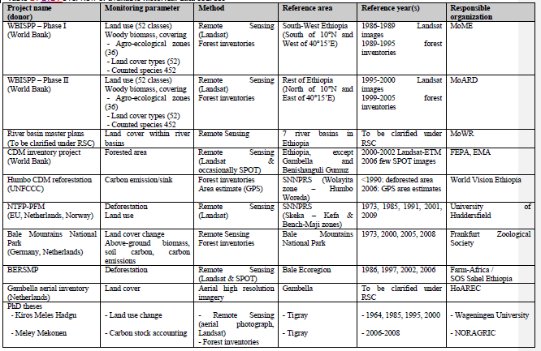

Slide 9
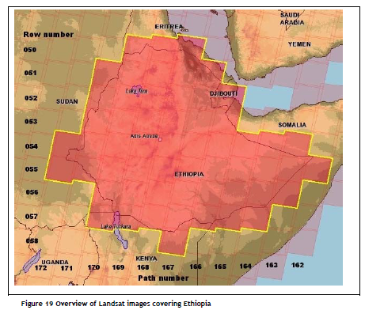
57 images

Slide 10
Global forest cover mapping and monitoring
Esri Releases New 2020 Global Land Cover Map
MODIS Land Cover Type/Dynamics
Copernicus land cover
GLCF
group work: Other Land cover layer available through GEE

Slide 11
Technical consideration of monitoring by satellites
Satellite monitoring involves a range of technical considerations to ensure accurate, reliable, and comprehensive data collection. Here are some key points:
Spatial Resolution
Temporal Resolution
Spectral Resolution
Radiometric Resolution
Data Processing
Coverage and Accessibility
Cost
Regulatory Considerations

Slide 12
Technical consideration of monitoring by satellites
These considerations are essential for leveraging satellite technology effectively for various monitoring purposes, including environmental observation, urban planning, agriculture, and disaster response.
The ongoing advancements in satellite technology and data analytics are expanding the potential applications of satellite monitoring even further.

